Slide 1
Entity Framework

Slide 2
DEVELOPMENT ENVIRONMENT - GET IT RUNNING ON YOUR LOCAL COMPUTER
Built using React.js/HTML/CSS, C#/.NET, Python, SQL
use OpenAI APIs
use Azure Fabric APIs
Dynamic webpage interaction with .NET and Python APIs
Static webpage links to Dynamic page on Azure
Local Computer
VS Code on local
VS on local
SSMS to Azure /
Fabric
Cloudflare
Static Front
1A
MS SQL Server
2A
Github
1B
API Layer
(future App Svc)
Azure
Dynamic Front
Mid-Tier
.NET/C#
2B
API Layer
(future App Svc)
Mid-Tier Python
FUTURE ENVIRONMENT - AZURE
Azure App Service APIs
OpenAI

Slide 3
Templates & TBD Initial Files
Interface
OpenAI
Approach Feature
Iapproaches.cs
AI Assistant Feature
Ichat.cs
PyNote Feature
IPyNote.cs
Client
Controller
Services
Python
Midtier
StoryLine Feature
ApproachesAPIController.cs
AI Assistant Feature
ChatAPIController.cs
PyNote Function
PyNote.cs
pyNoteService.cs
Approaches Feature
approachersService.cs
AI Assistant Feature
chatService.cs
PyNote Feacture
PyNoteService.cs
.NET
Midtier
Database
Approach Feature
Approaches.jsx
ApproachesService.js
AI Assistant Feature
Chat.jsx
chatService.js
PyNote Function
PyNote.jsx
pyNoteService.js
Dependency Injection
Approaches Feature
approaches TABLE
AI Assistant Feature
chatExchange TABLE
QAPairs TABLE
PyNote Feature
PyNotes TABLE
StoryLine Feature
Approaches.cs
AI Assistant Feature
ChatQues.cs
ChatAnscs
PyNote Function
PyNotes.cs
Model
Domain
Requests
Notes:
# Connectiong to DB with .Net
You should use the Console application in this project (Open Sabio.Db.ConsoleApp.sln)
and write code using the included projects to call all the procs in the `/SqlInit/Sabio_Address.sql` file.
The instructors will help you with the first couple of procs and then you finish the rest on your own using the resources available to you.
> :star: Be sure to get instructor help to run the `/SqlInit/Sabio_Address.sql` file.
Use the following Page to help you.
- [Working .Net Services Classes](https://github.com/sabiocode/wiki/blob/master/dotnet/data-access/service-class.md)
- [Data Service CRUD Operations Videos](https://training.sabio.la/courses/516025/lectures/10839166) to go with Data Access via Service Classes
- [How to Use DataProvider (ExecuteCmd)](https://github.com/sabiocode/wiki/blob/master/dotnet/data-access/DataProvider/DataProvider-ExecuteCmd.md)
- [How to Use DataProvider (ExecuteNonQuery)](https://github.com/sabiocode/wiki/blob/master/dotnet/data-access/DataProvider/DataProvider-ExecuteNonQuery.md)
---
# Background on Models
## Models
Models serve to carry data from one place to an other.
In many applications, Models are used in a variety of ways including partial updates, inserts and deletes.
In our application we will create a more refined architecture and create 4 different types of Models.
These four types will be named according to their utility or purpose
### Request Models
- These models will be used to pass data into a Controller or Service method
- These models will participate in Model Binding where data from an incoming request will be mapped to the properties of the given Model.
- They will be used to perform updates, inserts or deletes. More often than not, they will contain partial list of all the properties of the entities that they represent.
> Located in `Sabio.Models.Requests`
> :key: They are **PASSED* into Service Method calls or Controller Methods
### Response Models
- These Models will be the objects passed **out** of Api Controllers.
- Often times these Models will be used to wrap Domain models as they are passed out of the web application.
- All Response Models must inherit from BaseResponse.
> Located in `Sabio.Models.Responses`
> :key: They are returned from Controllers
### Domain Models
- These models will be used to most accurately represent the entities we store in our database.
- When returned, they should be fully hydrated with the data in the database.
- These files are located here at the following path. You should inspect the files there for more information.
> Located in `Sabio.Models.Domain`
> :key: They are returned from Service Method calls

Slide 4
Templates & TBD Initial Files
Interface
OpenAI
Approach Feature
Iapproaches.cs
AI Assistant Feature
Ichat.cs
PyNote Feature
IPyNote.cs
Client
Controller
Services
Python
Midtier
StoryLine Feature
ApproachesAPIController.cs
AI Assistant Feature
ChatAPIController.cs
PyNote Function
PyNote.cs
pyNoteService.cs
Approaches Feature
approachersService.cs
AI Assistant Feature
chatService.cs
PyNote Feacture
PyNoteService.cs
.NET
Midtier
Database
Approach Feature
Approaches.jsx
ApproachesService.js
AI Assistant Feature
Chat.jsx
chatService.js
PyNote Function
PyNote.jsx
pyNoteService.js
Dependency Injection
Approaches Feature
approaches TABLE
AI Assistant Feature
chatExchange TABLE
QAPairs TABLE
PyNote Feature
PyNotes TABLE
StoryLine Feature
Approaches.cs
AI Assistant Feature
ChatQues.cs
ChatAnscs
PyNote Function
PyNotes.cs
Model
Domain
Requests
Notes:
# Connectiong to DB with .Net
You should use the Console application in this project (Open Sabio.Db.ConsoleApp.sln)
and write code using the included projects to call all the procs in the `/SqlInit/Sabio_Address.sql` file.
The instructors will help you with the first couple of procs and then you finish the rest on your own using the resources available to you.
> :star: Be sure to get instructor help to run the `/SqlInit/Sabio_Address.sql` file.
Use the following Page to help you.
- [Working .Net Services Classes](https://github.com/sabiocode/wiki/blob/master/dotnet/data-access/service-class.md)
- [Data Service CRUD Operations Videos](https://training.sabio.la/courses/516025/lectures/10839166) to go with Data Access via Service Classes
- [How to Use DataProvider (ExecuteCmd)](https://github.com/sabiocode/wiki/blob/master/dotnet/data-access/DataProvider/DataProvider-ExecuteCmd.md)
- [How to Use DataProvider (ExecuteNonQuery)](https://github.com/sabiocode/wiki/blob/master/dotnet/data-access/DataProvider/DataProvider-ExecuteNonQuery.md)
---
# Background on Models
## Models
Models serve to carry data from one place to an other.
In many applications, Models are used in a variety of ways including partial updates, inserts and deletes.
In our application we will create a more refined architecture and create 4 different types of Models.
These four types will be named according to their utility or purpose
### Request Models
- These models will be used to pass data into a Controller or Service method
- These models will participate in Model Binding where data from an incoming request will be mapped to the properties of the given Model.
- They will be used to perform updates, inserts or deletes. More often than not, they will contain partial list of all the properties of the entities that they represent.
> Located in `Sabio.Models.Requests`
> :key: They are **PASSED* into Service Method calls or Controller Methods
### Response Models
- These Models will be the objects passed **out** of Api Controllers.
- Often times these Models will be used to wrap Domain models as they are passed out of the web application.
- All Response Models must inherit from BaseResponse.
> Located in `Sabio.Models.Responses`
> :key: They are returned from Controllers
### Domain Models
- These models will be used to most accurately represent the entities we store in our database.
- When returned, they should be fully hydrated with the data in the database.
- These files are located here at the following path. You should inspect the files there for more information.
> Located in `Sabio.Models.Domain`
> :key: They are returned from Service Method calls

Slide 5
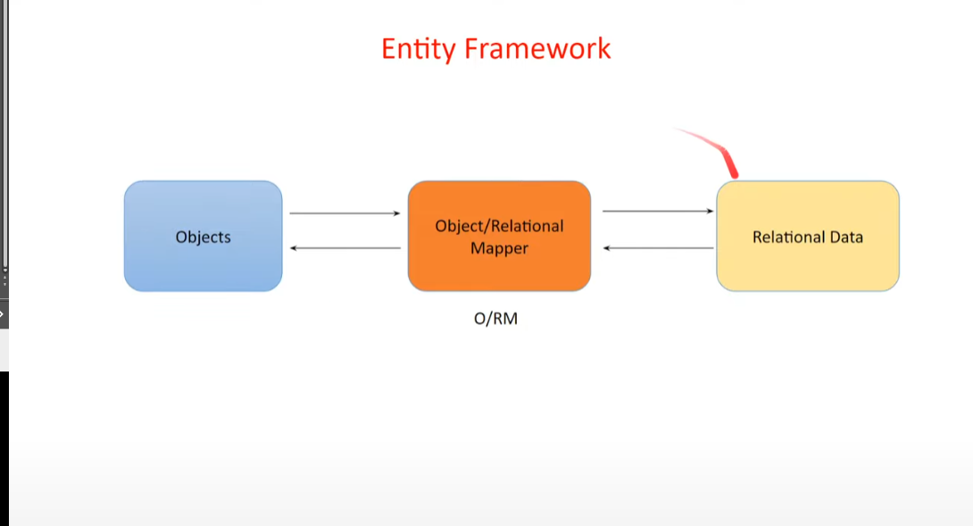

Slide 6
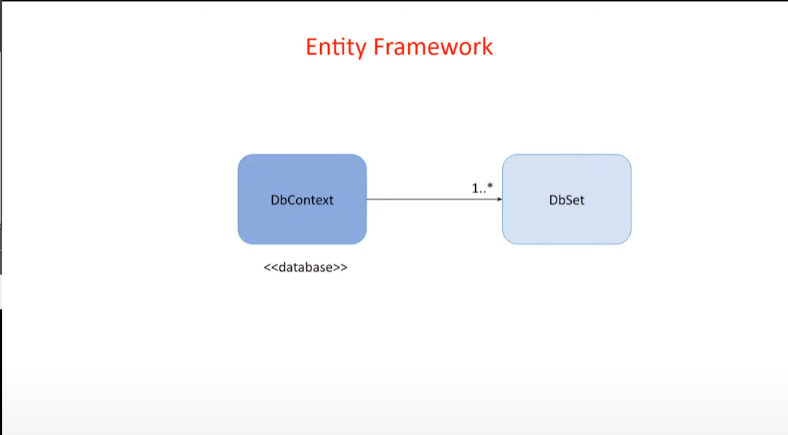
DbContext = Class
DbContext can have one are more DbSet which represent Tables in the database

Slide 7
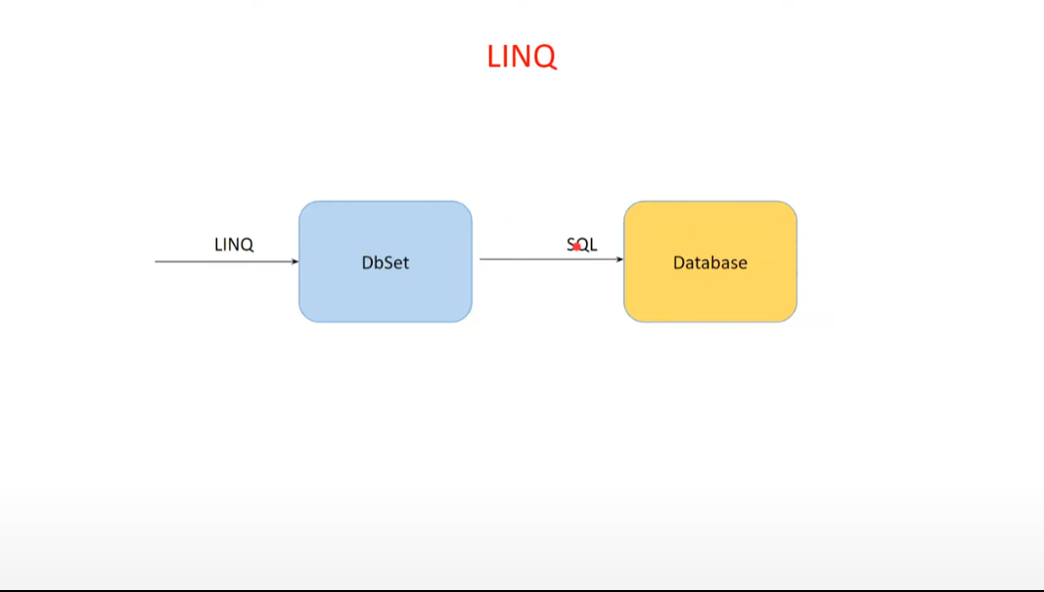
LINQ

Slide 8
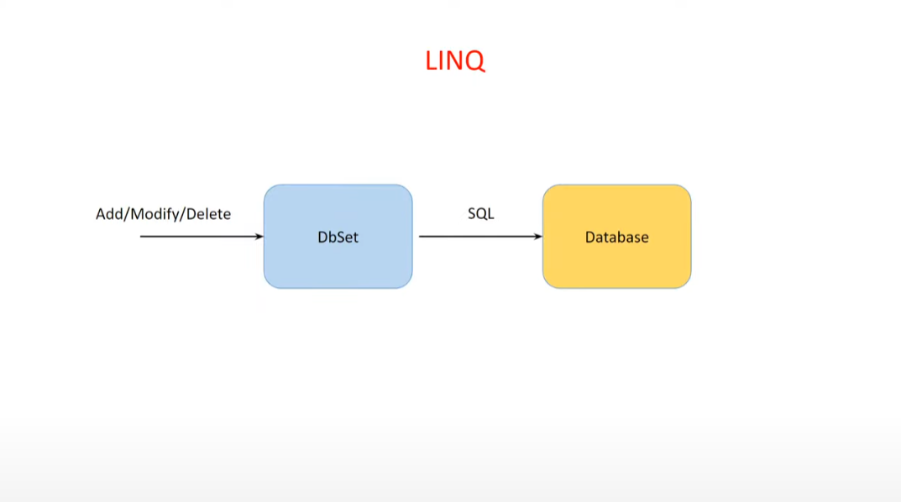
CRUD changes

Slide 9
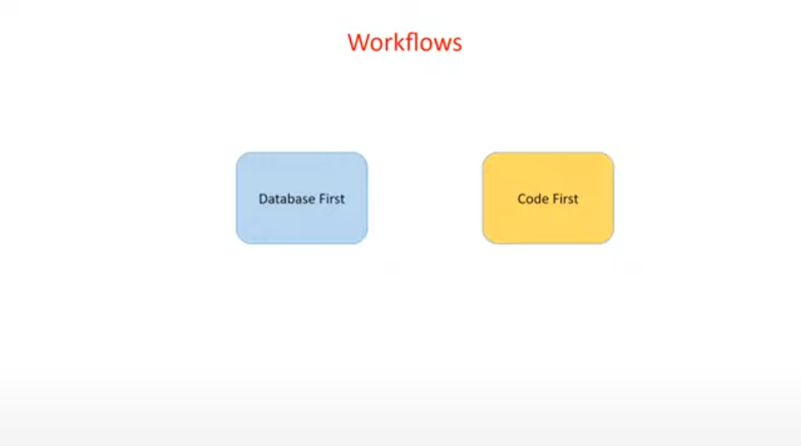
Define scheme in database and ER with stub out models, APIcontrollers, etc in C#/NET midtier
“Reverse Engineering” the db
In VS Package Manager Console, use the cmdlet “Scaffold-DbContext “ connection string” Microsoft.EntityFrameworkCore.SqlServer -ContextDir Data –OutputDir Models”
Define scheme in midtier with create tables and procedures in MS SQL Server on backend
In VS Package Manager Console, the first command is “Add-Migration InitialCreate”
The second command in VS Package Manager Console, the first command is “Update-Database”

Slide 10
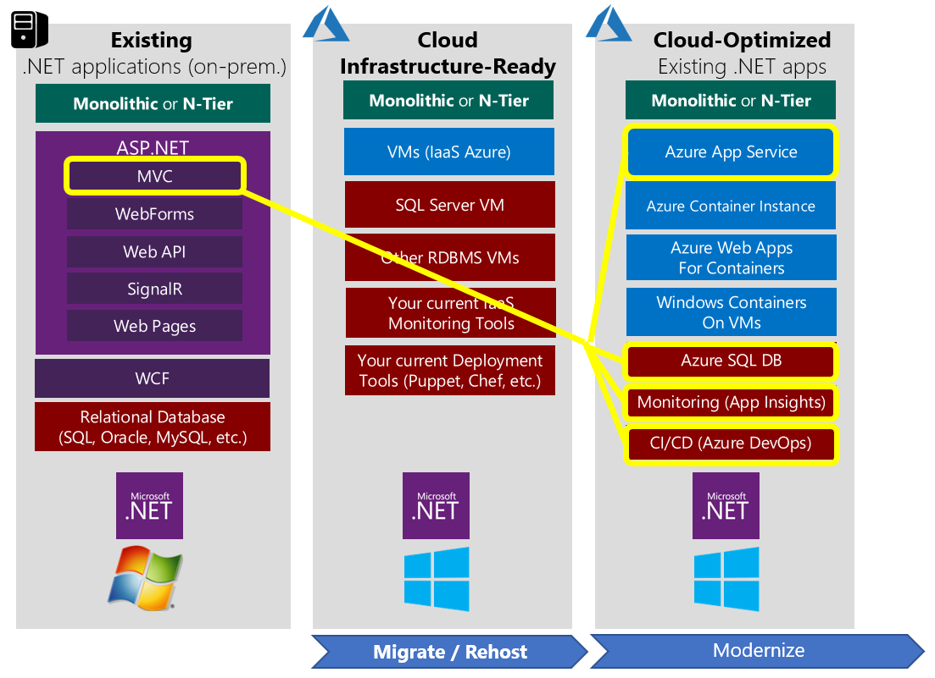
LOCAL
DEVELOPMENT
FUTURE
DEPLOYMENT

